Slide 1


Getting Started Guide
Syncing Google Classroom with Blackbaud SIS
Prepared for districts that use Blackbaud SIS

Slide 2
Overview
The following Getting Started Guide is intended for school districts that use Blackbaud SIS.
Google Workspace Admin Set-Up. Administrators will need to enable the initial setup within the Blackbaud SIS in order to enable syncing with Google Classroom, and then enable the connection in the Google Workspace Admin Console. Finally, all teachers must have an assigned license to connect to the SIS. See slides Google Workspace Administrator's section.
Teacher Set-Up. Once enabled by your Google Workspace Admin, teachers will have the ability to begin syncing grades from Google Classroom to their Blackbaud SIS. See slides 16-22.
Your feedback is important to us. Learn more about how to provide feedback to us directly here.
For any immediate questions, please visit our FAQ (in the slides below) and online Help Center. You can also email the Classroom team at oneroster-classroom-pilots@google.com.

Slide 3
Google Workspace Administrators
Connecting Blackbaud SIS and Google Classroom

Slide 4
Overview for Admins
Part I: Setup within Blackbaud SIS
Blackbaud SIS Setup Instructions
Part II: Setup within Google Workspace Admin Console
Connect SIS with Classroom (Set up Connection)
Assign licenses

Slide 5
Google Workspace Administrators
Part I: Setup within Blackbaud SIS

Slide 6
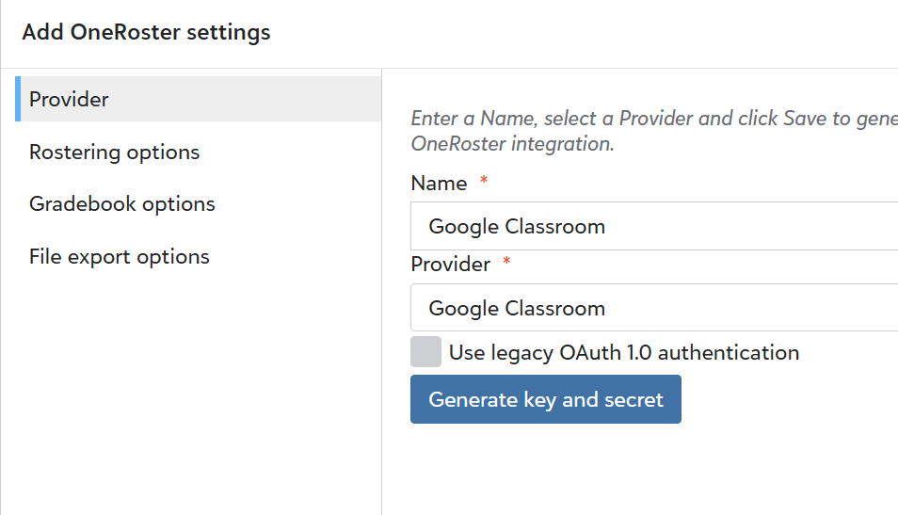
Blackbaud SIS Setup Instructions
How admins can generate and retrieve the OAuth Key, Secret, and URL from Blackbaud SIS
1
Log into Blackbaud Education management and navigate to Core.
2
Using the navigation, select Settings, Integration settings. On the page that opens, select the OneRoster Settings tab.
2
3
Select Add.
4
Enter a Name (e.g., Google Classroom) and select Google Classroom as the Provider.
4
Select Generate key and secret.
Tip: You can return to this page after the session has ended to obtain the key and secret.

Slide 7
Google Workspace Administrators
Part II: Setup within Google Workspace Admin Console

Slide 8
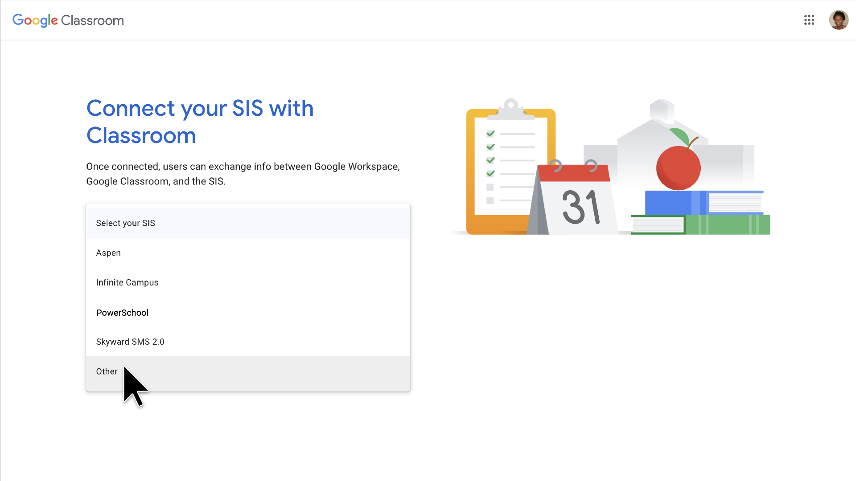
Google Workspace Admins: Connect SIS with Classroom
Once you have generated and retrieved the OAuth Key, Secret, and URL from your Blackbaud SIS, your Google Workspace Admin must login to Google Classroom and follow these steps:
1
Go to classroom.google.com/admin.
2
Click the Connect to Google button.
2
3
You will be prompted to enter the Host URL, Client Key, and Client secret. Visual on the next slide.

Slide 9
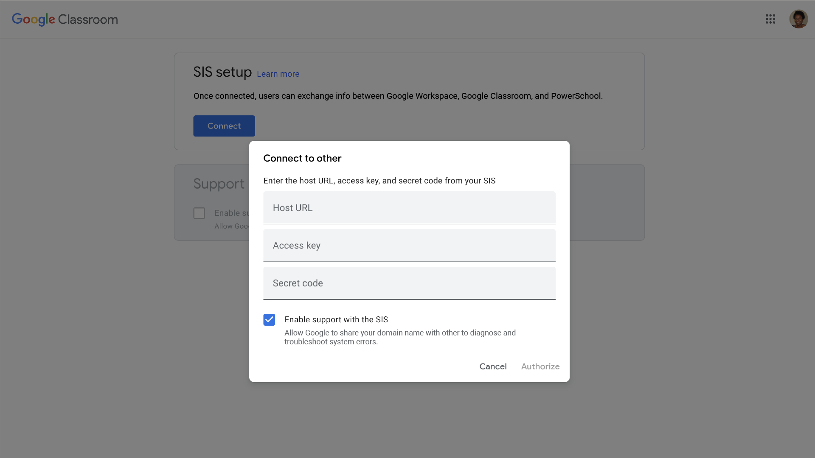
Google Workspace Admins: Connect SIS with Classroom
4
Input the corresponding API information into Google Classroom:
Host URL =
https://api.sky.blackbaud.com/afe-rostr/ims/oneroster/v1p1/
Access Key = Client key
Secret code = Client secret
Note: The client key and client secret were generated as part of the instructions during Blackbaud SIS Setup.
Click Authorize.
Tip: If you receive an error, try refreshing your Google Classroom page.
5

Slide 10
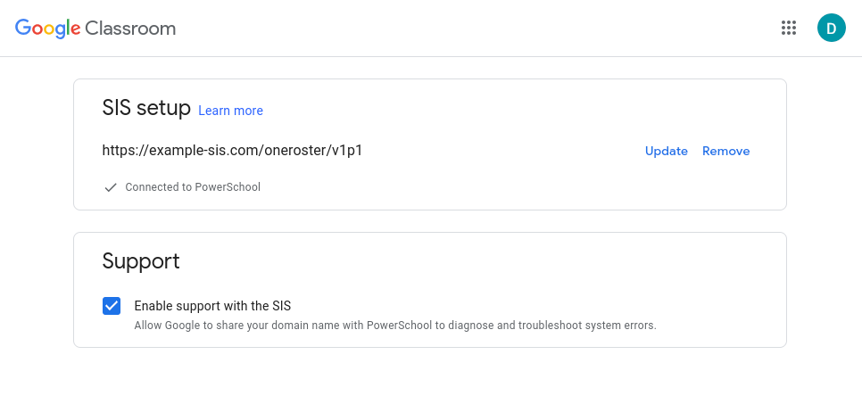
Google Workspace Admins: Connect SIS with Classroom
6
Once authorized in Google Classroom, administrators have the option to enable SIS support communication:
Enable support with the SIS: Enabling this option will allow Google support and engineering teams to share your domain information with SIS providers to improve troubleshooting efforts.
Your teachers will now have the ability to import roster information and export grades once licenses are assigned!

Slide 11
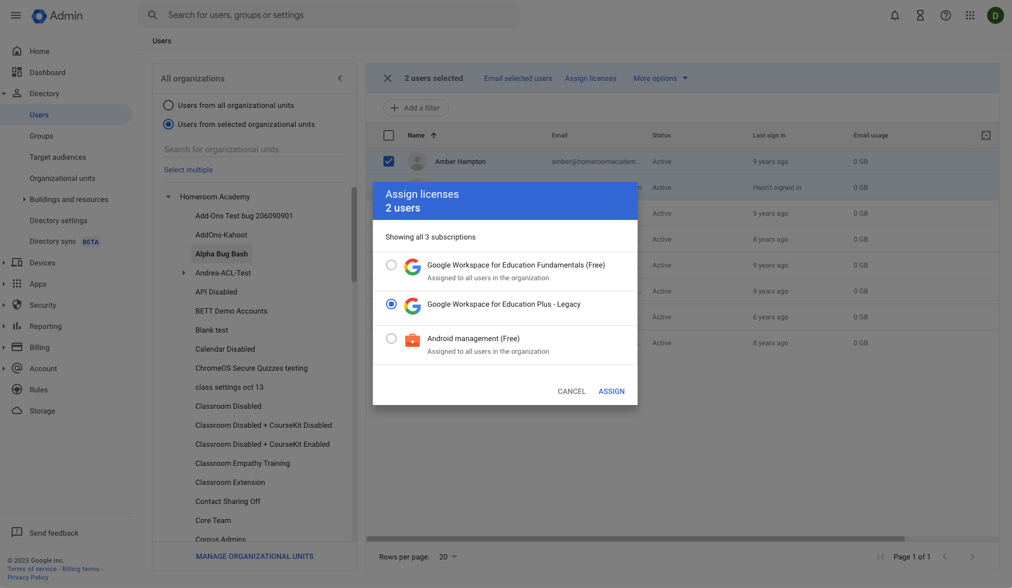
Google Workspace Admins: Assign Licenses
7
Teachers must have an assigned Teaching & Learning or Education Plus license to connect to the SIS. After purchasing, you can assign licenses in multiple ways:
Automatically assign a license to every user in your organization
Manually assign licenses on the Users page
Manually assign licenses on an individual user’s page
Assign licenses to multiple users from a CSV file
Once a teacher has an assigned license, they can connect to the SIS.
See How licensing works in Google Workspace Admin Help for additional information.

Slide 12
Teacher Setup

Slide 13
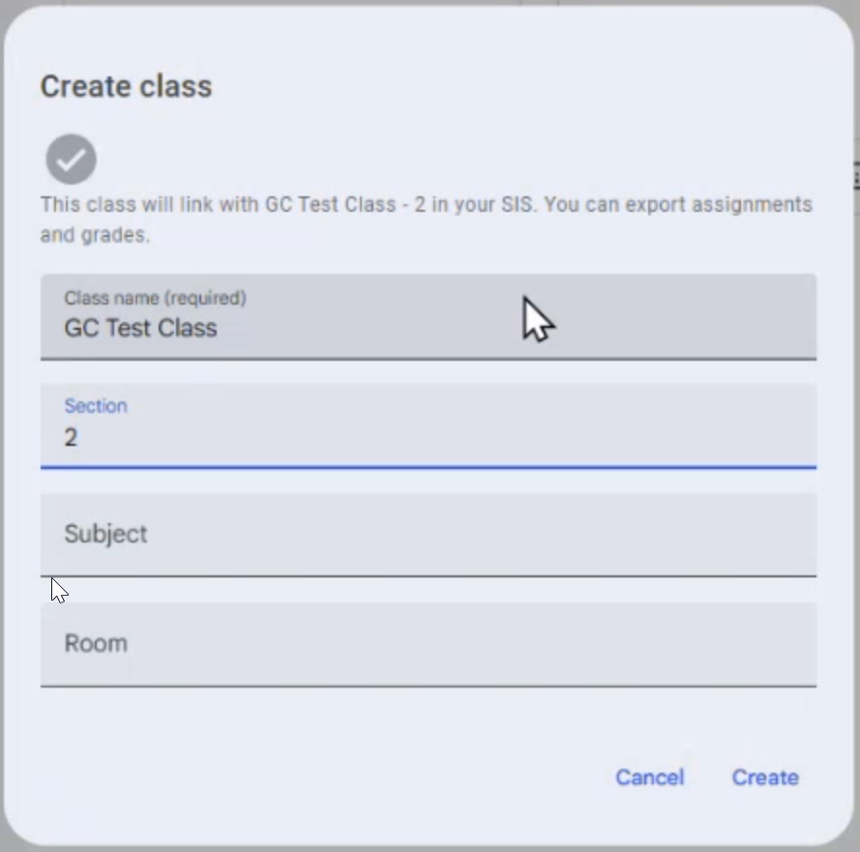
Teachers: Add a class
1
Login to Google Classroom.
On the Home page, select the plus button and choose Create class.
2
1
3
You will be prompted to choose a class from the drop down menu. You will see a list of classes from your Blackbaud SIS.
4
Select Next and enter course information.
5
Select Create.
Tip: If you receive an error, try refreshing your Google Classroom page.

Slide 14
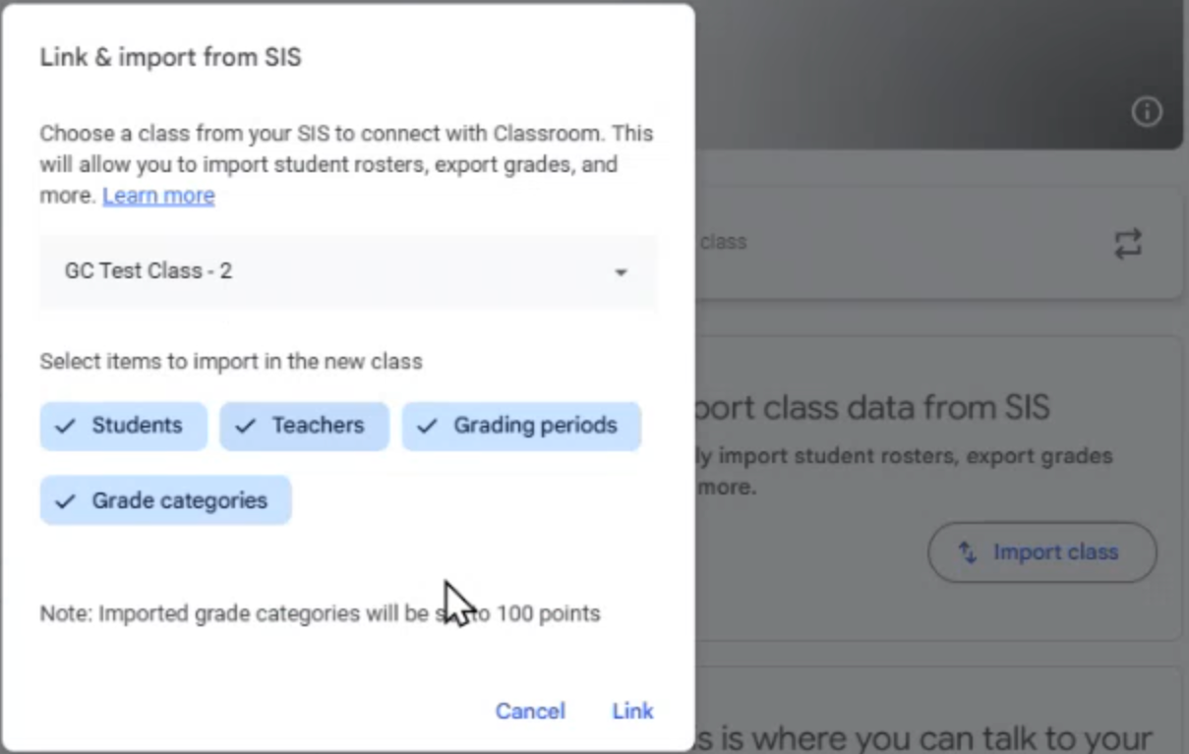
Teachers: Import class data from SIS
1
Login to Google Classroom.
Select a class under Teaching and, under Import class data from SIS, click Import class.
2
1
3
Click Link.
Note: Syncing Classroom classes to SIS classes relies on email addresses being identical in Classroom and in the SIS. Teacher and student email addresses in Classroom must match teacher and student addresses in the SIS.
Check out the FAQ (in the slides below) and Help Center for more information.

Slide 15

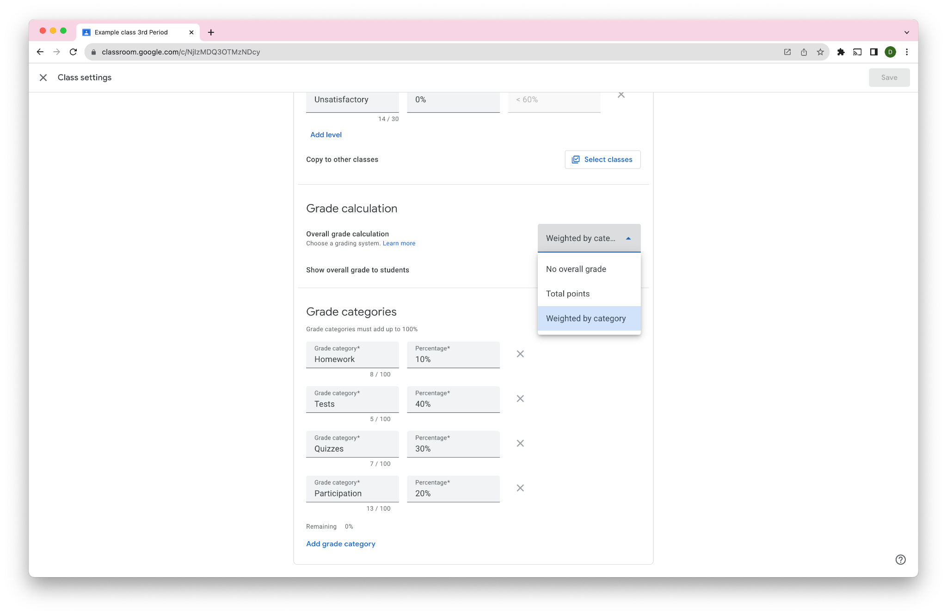
Teachers: Set up grading categories
1
Go to the Class > Settings page
Select the Grade Calculation (No overall grade, Total points, or Weighted by Category)
Add Grade Categories
If you selected Weighted by Category, add the percentage weight for each category (Note: This will not affect the weights in your SIS Gradebook. It will only be used to show a Google Classroom calculated gradebook grade to students). If you selected “No overall grade” or “Total points,” select the default points per category.
2
1
3
4
Note: The Grade Categories must match the exact text in your SIS Gradebook. Make sure that the spelling is correct and there are no trailing spaces.

Slide 16
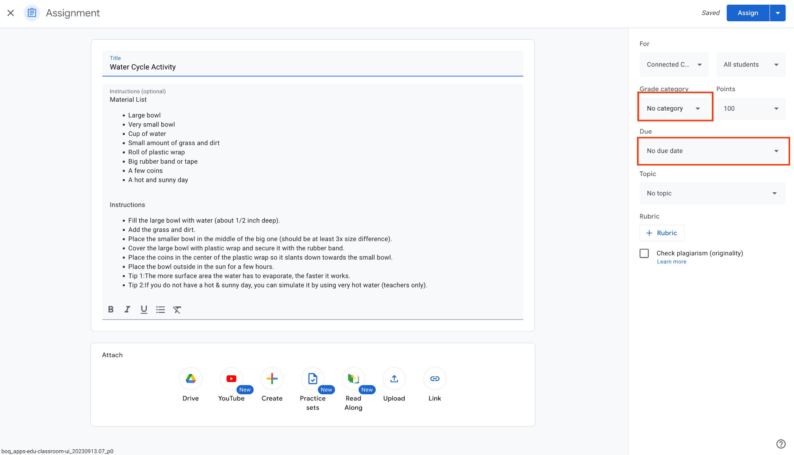
Teachers: Create your assignment
1
Create your assignment
For each assignment, make sure to include a due date and grade category
2
1
3
If due date or grade category are blank, you will receive an error when attempting to export
4
Once complete, select ‘Assign’
Reminder: You’ll have to set a grade category + due date for every assignment before exporting. If you have not set up grading categories, you can set them up in your Class Settings page.

Slide 17
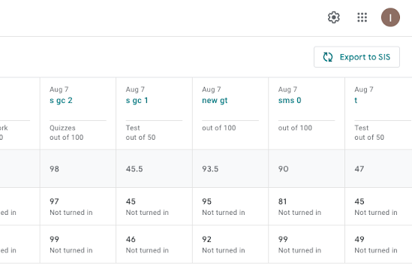
Teachers: Export to SIS
5
Navigate to your Gradebook in Google Classroom by selecting the Grades tab
Note:
Grades must be returned to students before they can be synced.
All grades must have a numerical value to be pushed to the SIS (Note: Grading Scales are compatible since each scale value has a corresponding numerical value).
If a student does not exist in your SIS, but does exist in Classroom, or their email does not match, that student's grades will not sync with the SIS.
1
6
To sync grades, click the Export to SIS button in the upper right hand corner.
2
Your students’ grades will now be synced with your SIS!

Slide 18
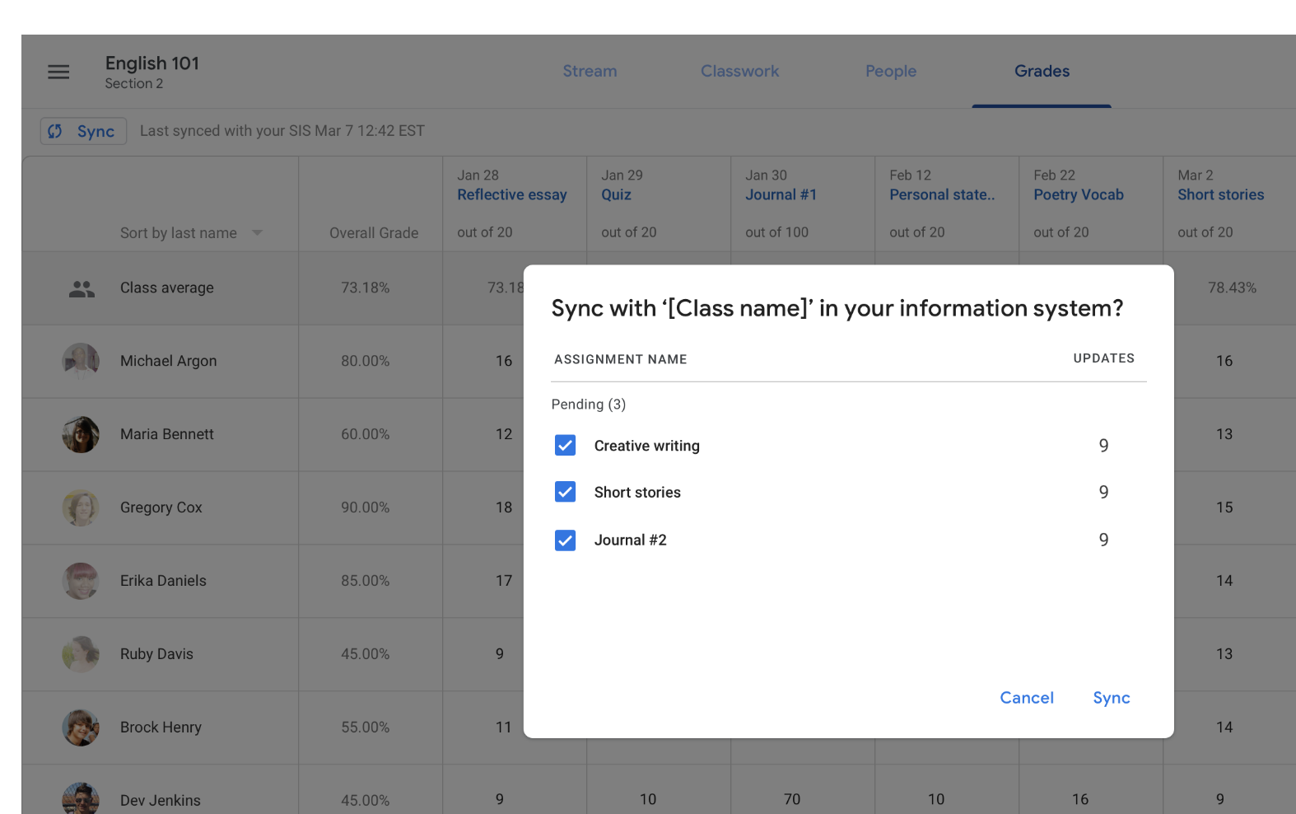
Teachers: Export assignments and grades
7
When prompted, you can choose which assignments to export.
1
8
You can also view previously excluded grades and include if applicable.
Note: The number of updates indicates how many grades for the assignment have been updated since the last sync.
Tip: If you’re having trouble exporting, visit our Help Center for suggested solutions.

Slide 19
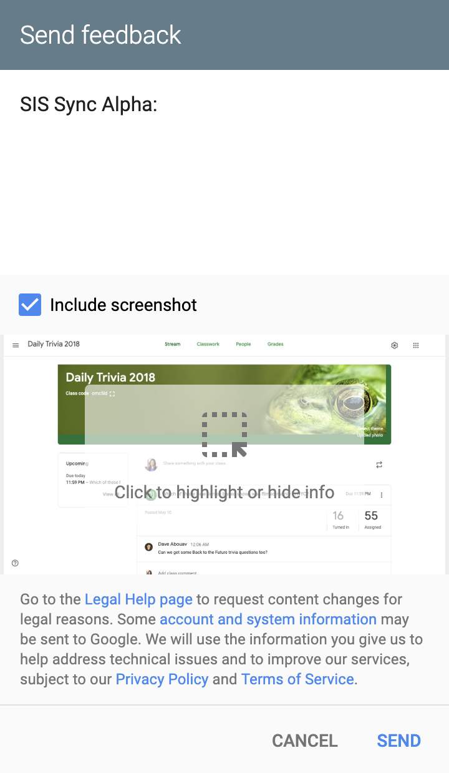

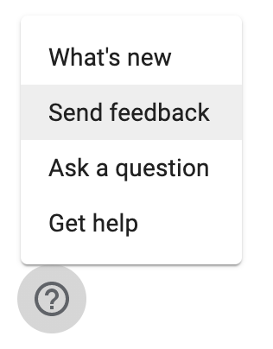
Providing Feedback
Please provide feedback to us directly via the
Send Feedback User Tool:
At the bottom left, click Help a and then > Report issue or request feature.
Start comment with ‘Blackbaud Alpha Pilot’.
Please include screenshots when possible.
If you have any additional questions or feedback about this pilot, please visit our Help Center or email classroom-sis-external@google.com.
Grade Sync Beta:
1

Slide 20
FAQ

Slide 21
Q: The grade export option does not appear in my Classroom Settings page. Why can’t I access it?
A:
Allowlist Domain: Make sure you’re logged in to your allowlisted domain.
  Tip: Try your institution account; make sure you’re not trying to access this through your personal account.
SIS Provisioning: Make sure you’ve set up the proper prerequisites from your information system provider.
Google Provisioning: Make sure your domain uses Google Workspace for Education Plus or the Teaching and Learning Upgrade.
License Assignment: Make sure you have a Teaching & Learning or Education Plus license assigned to you.
Reach out to your Information System Point of Contact: If you’re still having issues, check with your Google Workspace Admin for troubleshooting or contacting your Information System Customer Support. You can also email oneroster-classroom-pilots@google.com.
Q: What data can I export to my information system during the pilot?
A: Teachers will be able to manually link new and existing Google Classroom classes to your information system, push assignments and grades from Classroom, and unlink any linked class. Note: All grades must have a numerical value to be pushed to the SIS.
Q: If my Classroom grades are categorized (e.g., quizzes, exams), will the grading categories sync to my information system?
A: Yes, grading categories will carry over. In fact, Classroom grades must be categorized, which means every teacher must: (a) set up categories in Settings; (b) assign a category to each assignment that needs to be exported.
Q: Can I choose to export grades from a specific course or assignment?
A: Yes. From Google Classroom, you will be able to manually check which classes and assignments you’d like to export to your student information system. We show eligible classes based on the email address of the teacher. We match that email address to the email address on file in the SIS/MIS and display all the relevant classes listed for that teacher. Once the teacher selects the class, we store that mapping between the Classroom class and the information system class so we can successfully push grades.

Slide 22
Q: Is there a way to export a Standards Based Grading scale to my information system?
A: As of today, only grades that exist in Google Classroom can be exported. Classroom does not use Standards Based Grading.
Q: Who can see my Gradebook?
A: The Classroom Gradebook is only visible to teachers. Parents and students do not and will not have access as of right now.
Q: If I don’t have Gradebook in Classroom, can I participate?
A: No, the option to export is only available via the Gradebook in Classroom, not the student view page.
Q: Is there a way to use this feature with only a select group of teachers?
A: Google allows access to the entire domain at this time.
Q: What happens if rosters don’t match when it comes time to export grades?
A: The teacher email and student emails in Classroom must match the emails used in the SIS. On each grade export, Classroom will export grades for any students in Classroom that are also listed in the linked SIS course, even if those students weren't enrolled in the SIS course previously. Grades will not be exported for students who are not in the roster of both the Classroom class and the linked SIS course.
Q: Am I able to import data from my SIS/MIS?
A: The ability to import class lists/students, grading categories and grading periods is part of this feature and available once an administrator configures your connection.

Slide 23
Q: I exported grades from Classroom to my information system. What happens if I change the Classroom grade and export again?
A: If you change a Classroom grade that you previously exported, that new grade will overwrite the grade originally pushed to your information system when you re-export.
Q: What measures are being taken to ensure data privacy?
A: Our Privacy Policy describes how the product collects, uses, and shares information. You may also review the Google Workspace For Education Privacy Notice for more information. If you have any questions please do not hesitate to reach out to the Google Classroom team at oneroster-classroom-pilots@google.com.
Q: Can I share this pilot with other administrators?
A: Yes, please follow the process below.
Please contact your account representative (if known) or the SIS/MIS support team to get started on set up.
The team will confirm eligibility and discuss activation of any necessary licenses.
Q: How can I give feedback?
A: Your feedback is extremely valuable to us. Please submit your feedback via “Send feedback” button in Classroom. When submitting feedback, please include a screenshot and start the report with Blackbaud SIS Pilot.’

Slide 24
Thank you!
For any immediate questions, please email classroom-sis-external@google.com
You can also see our FAQ (in the slides above) or visit the Help Center for more information.

